Slide 1



HR data analysis
View in Power BI
Last data refresh:
11/1/2022 1:54:35 PM UTC
Downloaded at:
11/2/2022 3:19:00 PM UTC

Slide 2
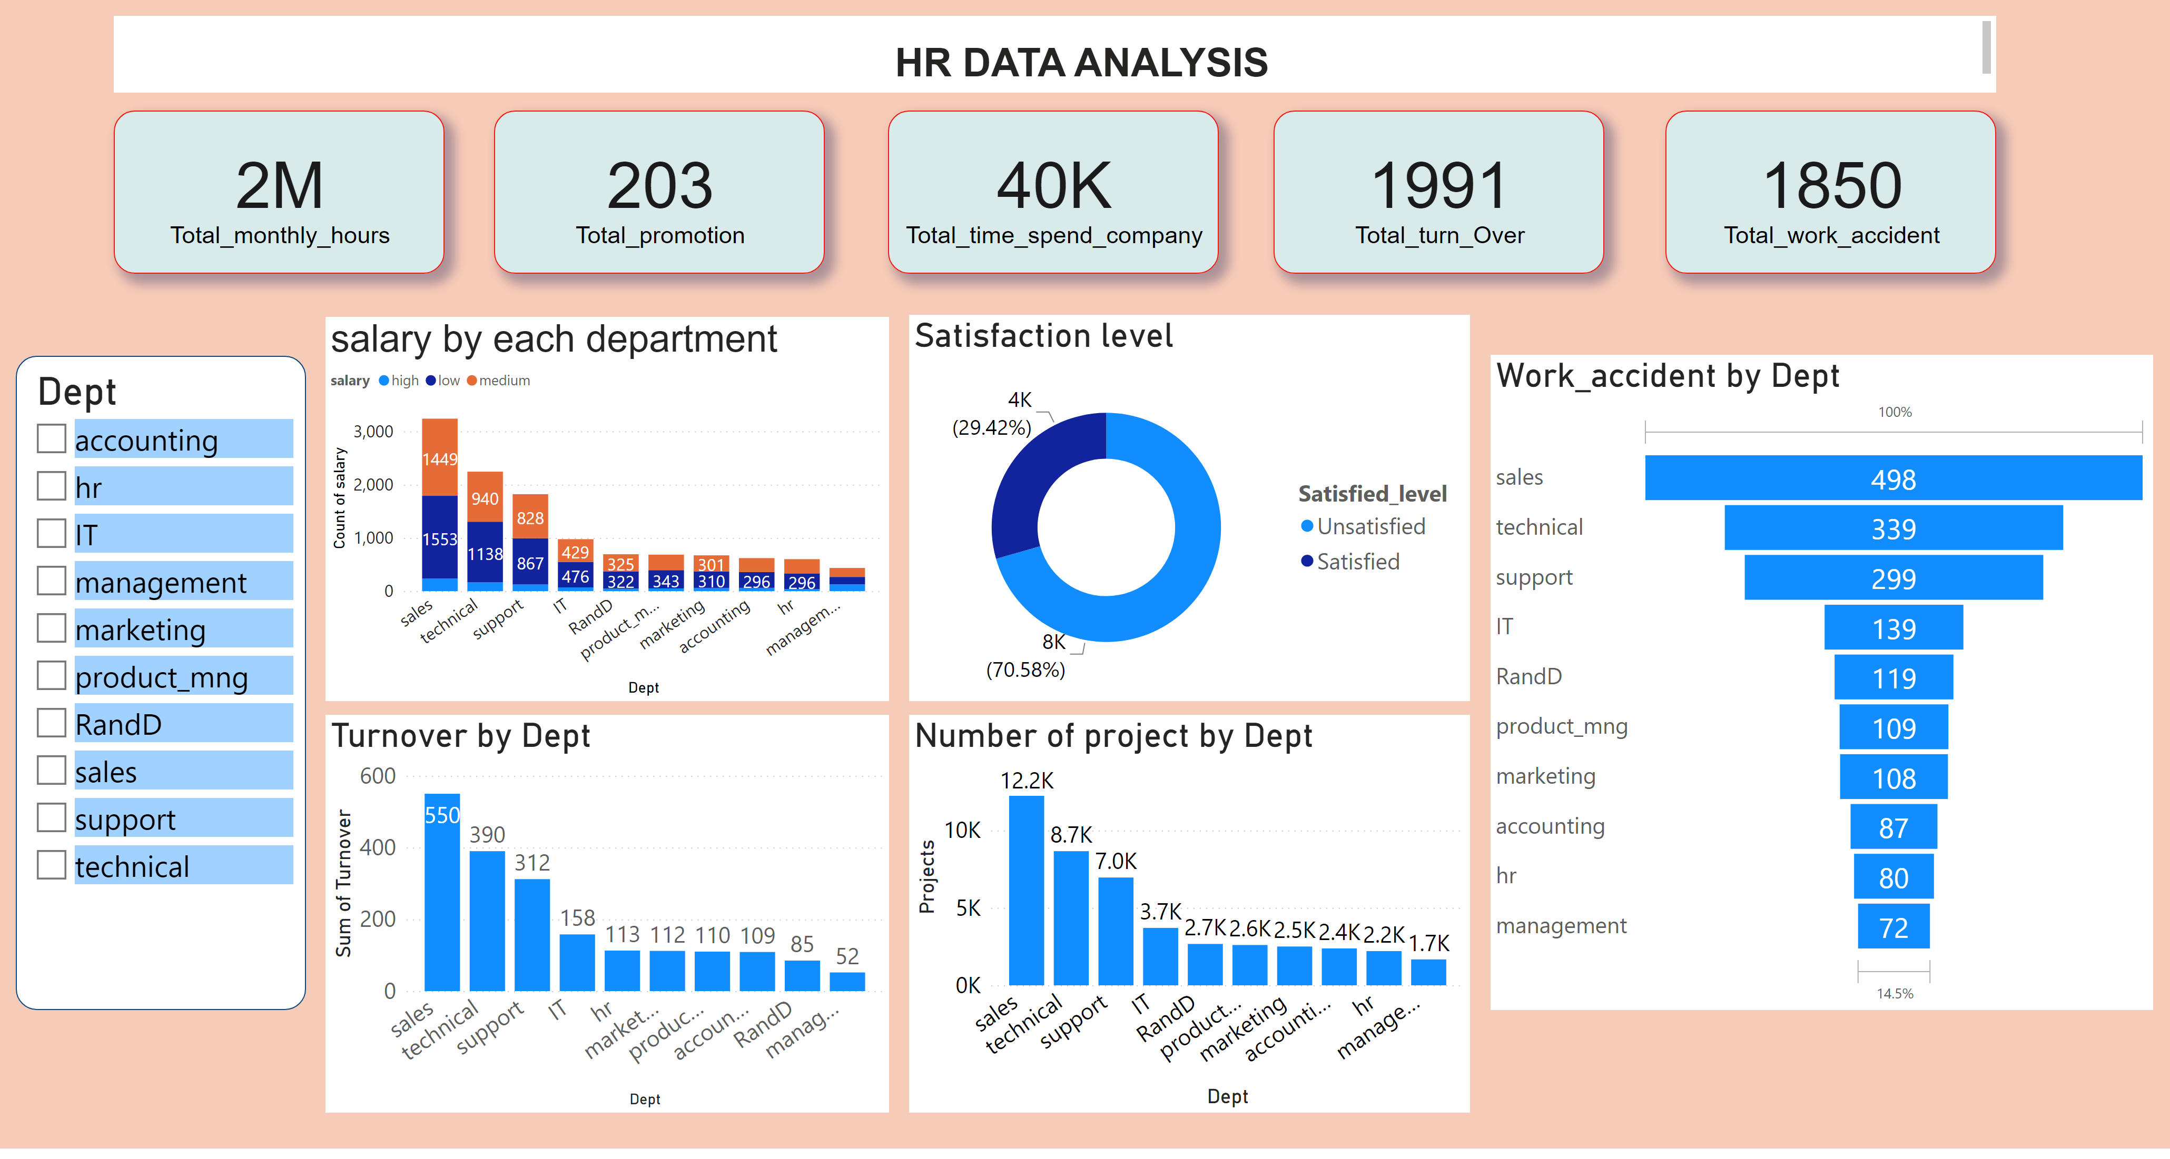
Page 1
Notes:
textbox
No alt text provided
slicer
No alt text provided
card
No alt text provided
salary by each department
No alt text provided
Satisfaction level
No alt text provided
Turnover by Dept
No alt text provided
Number of project by Dept
No alt text provided
Work_accident by Dept
No alt text provided
card
No alt text provided
card
No alt text provided
card
No alt text provided
card
No alt text provided

